Slide 1



MACHINE INTELLIGENCE
Srinivas K S
Department of Computer Science and Engineering

Slide 2


MACHINE INTELLIGENCE
SVD
Srinivas K S
Department of Computer Science and Engineering

Slide 3
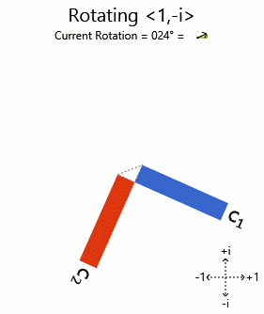
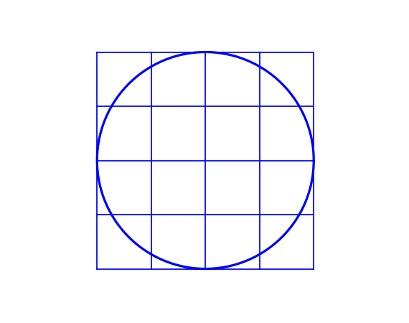
MACHINE INTELLIGENCE
Singular Value Decomposition : SVD
What hapeens when you multiply matrix with a vector
The Vector Scales
The Vector Rotates
The Vector Scales and Rotates

Slide 4
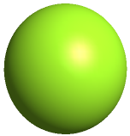
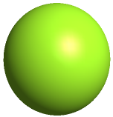
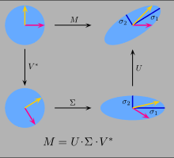
MACHINE INTELLIGENCE
Singular Value Decomposition : SVD
  Matrix multiplied with vector results in scaling and rotation
  For a set of vectors that form a circle – the same thing happens
  That’s the sum and substance of singular value decomposition
  Find 2 guys – matrices that rotate and scale.

Slide 5
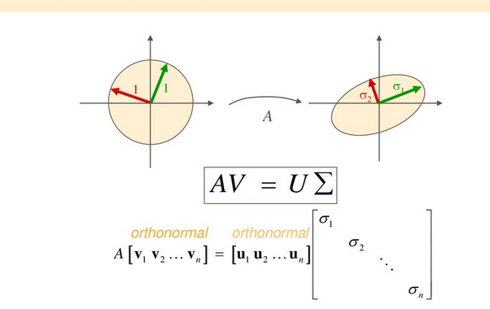
MACHINE INTELLIGENCE
Singular Value Decomposition : SVD
A sphere of N-Dimensions
By multiplying it with a matrix A
New coordinate system U is called principal axis
Stretched by a scaling factor α are called singular values

Slide 6
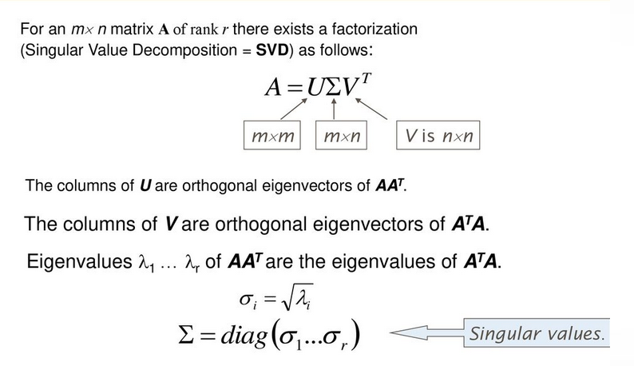
MACHINE INTELLIGENCE
Singular Value Decomposition : SVD
For any matrix mxn

Slide 7
MACHINE INTELLIGENCE
Singular Value Decomposition : SVD
NOTE:
The matrix AAᵀ and AᵀA are very special in linear algebra.
Consider any m × n matrix A, we can multiply it with Aᵀ to form AAᵀ and AᵀA separately.
These matrices are
symmetrical,
square,
both matrices have the same positive eigenvalues, and
both have the same rank r as A.

Slide 8

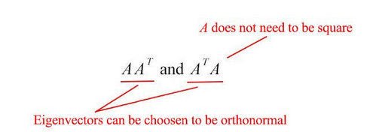
MACHINE INTELLIGENCE
Singular Value Decomposition : SVD
Recollect
AAᵀ and AᵀA are symmetric
we can choose its eigenvectors to be orthonormal (perpendicular to each other with unit length)
We name the eigenvectors for AAᵀ as uᵢ and AᵀA as vᵢ
call these sets of eigenvectors u and v the singular vectors of A.
Both matrices have the same positive eigenvalues.
The square roots of these eigenvalues are called singular values.

Slide 9
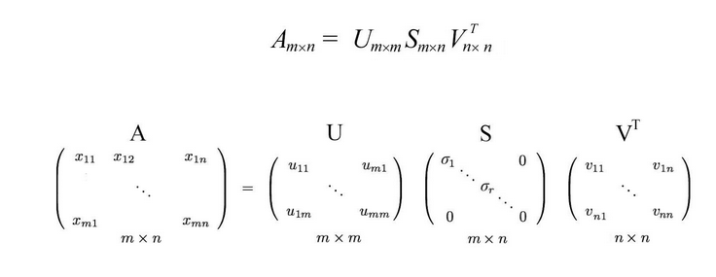
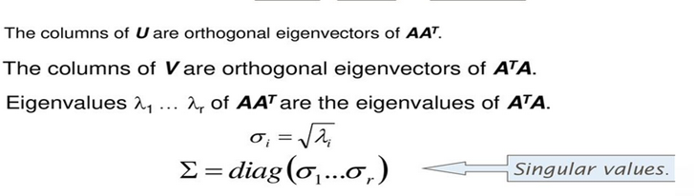
MACHINE INTELLIGENCE
Singular Value Decomposition : SVD
SO SVD IS ALL ABOUT FINDING 3 MATRICES

Slide 10
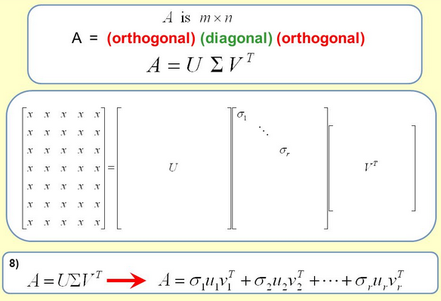
MACHINE INTELLIGENCE
Singular Value Decomposition : SVD
ONE MORE TIME

Slide 11
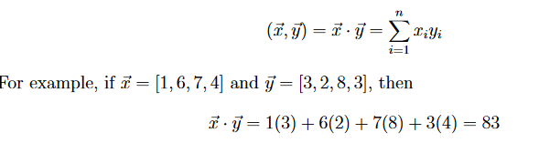

MACHINE INTELLIGENCE
Singular Value Decomposition : SVD
Inner Product
2 Vectors are orthogonal if their inner product equals ___ i.e the angle between them is ___

Slide 12
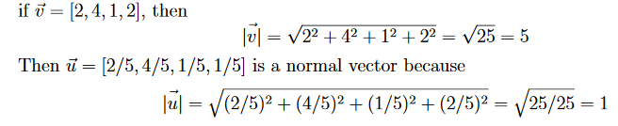
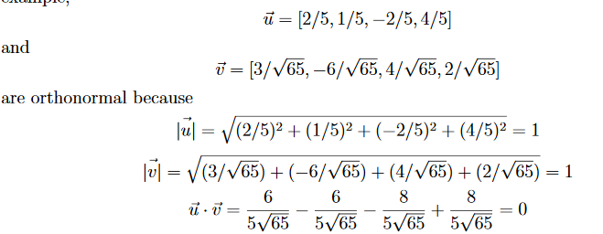
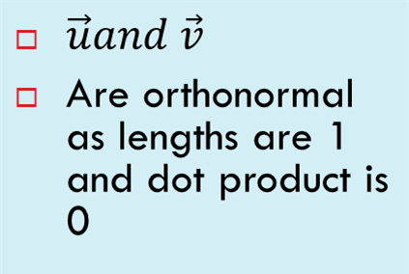
MACHINE INTELLIGENCE
Singular Value Decomposition : SVD
NORMAL AND ORTHONORMAL VECTORS

Slide 13
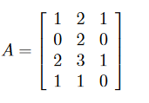

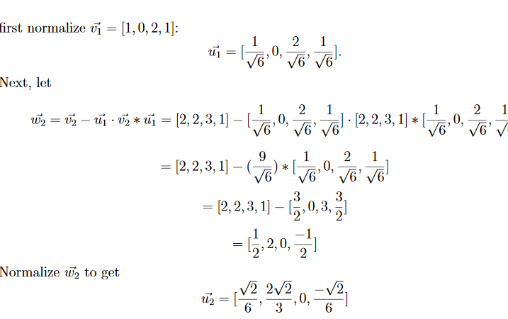
MACHINE INTELLIGENCE
Singular Value Decomposition : SVD

Slide 14
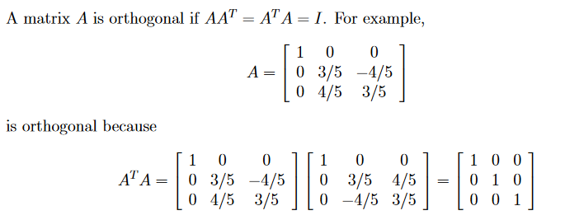
MACHINE INTELLIGENCE
Singular Value Decomposition : SVD

Slide 15

MACHINE INTELLIGENCE
Singular Value Decomposition : SVD
Singular Value Decomposition 3 views
Capturing the essence of moving from higher to lower dimensions
method for identifying and ordering the dimensions along which data points exhibit the most variation
method for transforming correlated variables into a set of uncorrelated ones that better expose the various relationships
Let us look at a mxn matrix.
This can be expressed as a product of 3 matrices

Slide 16

MACHINE INTELLIGENCE
Singular Value Decomposition : SVD
Some properties of this decomposition
S is a diagonal matrix containing the square roots of Eigen values from U or V in descending order
Lets work thru an example
Columns of U are orthonormal eigenvectors of AA^{T}
Columns of V are orthonormal eigenvectors of A^{T}A

Slide 17




Lets compute U first
MACHINE INTELLIGENCE
Singular Value Decomposition : SVD
A^{T}
AA^{T}
Eigen Values and Eigen Vector

Slide 18
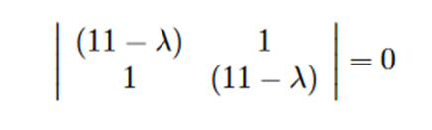
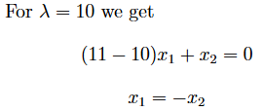
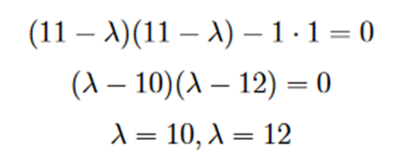


Solve for Eigen Value
MACHINE INTELLIGENCE
Singular Value Decomposition : SVD
Plug this back

Slide 19
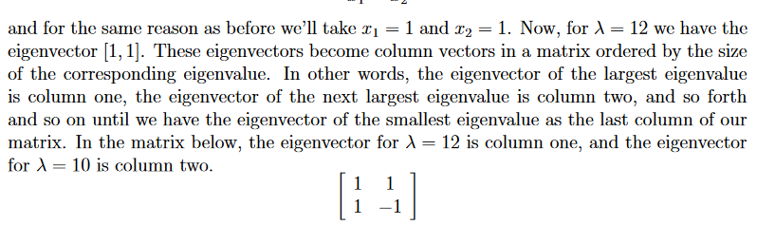
MACHINE INTELLIGENCE
Singular Value Decomposition : SVD

Slide 20


MACHINE INTELLIGENCE
Singular Value Decomposition : SVD
Similarly do this for V Please which is A^{T}A
Now Ortho normalize this by Gram Schmidt

Slide 21
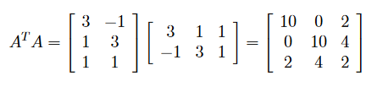
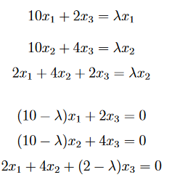

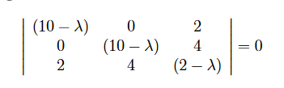

MACHINE INTELLIGENCE
Singular Value Decomposition : SVD
V Calculations

Slide 22
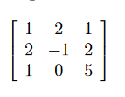
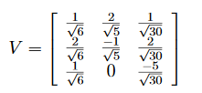

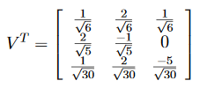
Eigen Values and Eigen Vectors
MACHINE INTELLIGENCE
Singular Value Decomposition : SVD

Slide 23
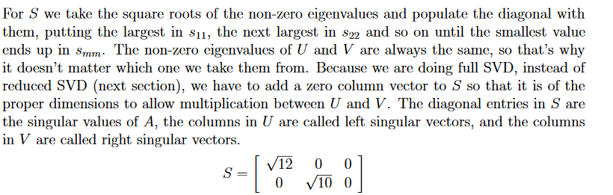
Finally S
MACHINE INTELLIGENCE
Singular Value Decomposition : SVD

Slide 24
Applications
MACHINE INTELLIGENCE
Singular Value Decomposition : SVD
Page Ranking
Recommendation Systems
Image Compression
Facial Recognition
Noise reduction

Slide 25
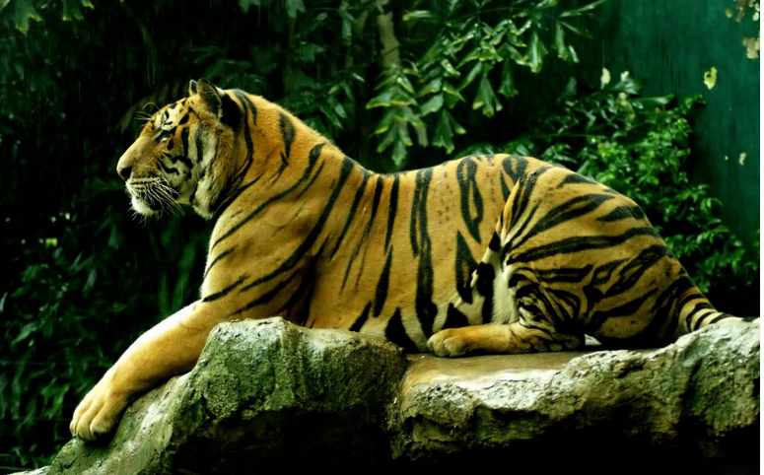
You My Dear Friends are all Tigers
MACHINE INTELLIGENCE
Singular Value Decomposition : SVD

Slide 26
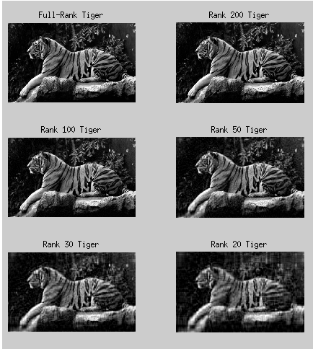
Just 20% of your high dimensions in enough to still show you as Tigers
MACHINE INTELLIGENCE
Singular Value Decomposition : SVD

Slide 27

THANK YOU
Srinivas K.S
Department of Computer Science and Engineering
srinivasks@pes.edu

